Slide 1
Metagenomics for Fast, and Precise Pathogen Identification
Sehgeet Kaur
sehgeetk@vt.edu

Slide 2










Metagenomics
Strain level identification
High resolution
Branch of genomics that involves the study of genetic material recovered directly from environmental samples
STRENGTHS
Pathogen agnostic detection
High senstivity
Fast, No culturing

Slide 3





Metagenomics
Reference
database
Huge data
& space
Branch of genomics that involves the study of genetic material recovered directly from environmental samples
CHALLLENGES
Host or other
microbe sequences
Low abundance
of pathogen
False positives
or negatives
Notes:
We will be only able to identify the genomes which are sufficiently similar to the genomes in the reference database.
So the current method relies on traditional taxonomy-based classification in which we match our sequences to custom build reference databases using NCBI or GTDB. GTDB is another taxonomy database like NCBI, but the key difference is that GTDB uses genome similarity to group microbes in a more consistent way than NCBI. Each organism gets a taxonomic identifier or taxid to help classify it. But there are some problems most importantly—neither NCBI nor GTDB assigns taxids at the within-species level. That means we are not able to get the critical strain-level details, which are exactly what we need when identifying pathogens or tracking outbreaks.

Slide 4
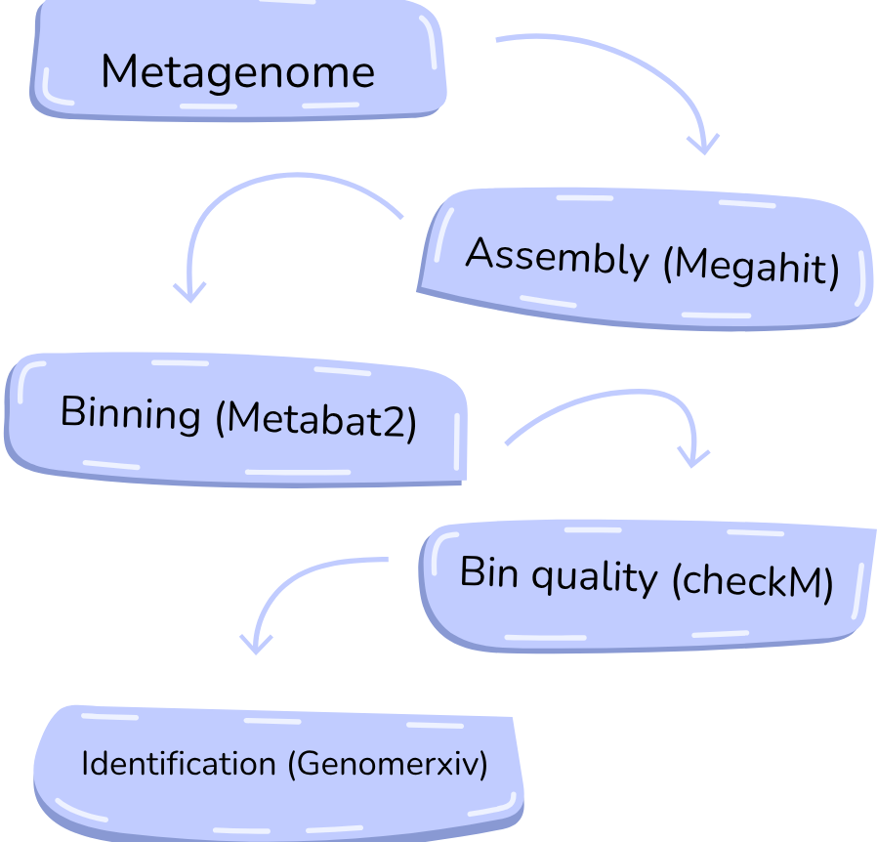
Approach for metagenomic classification

Slide 5
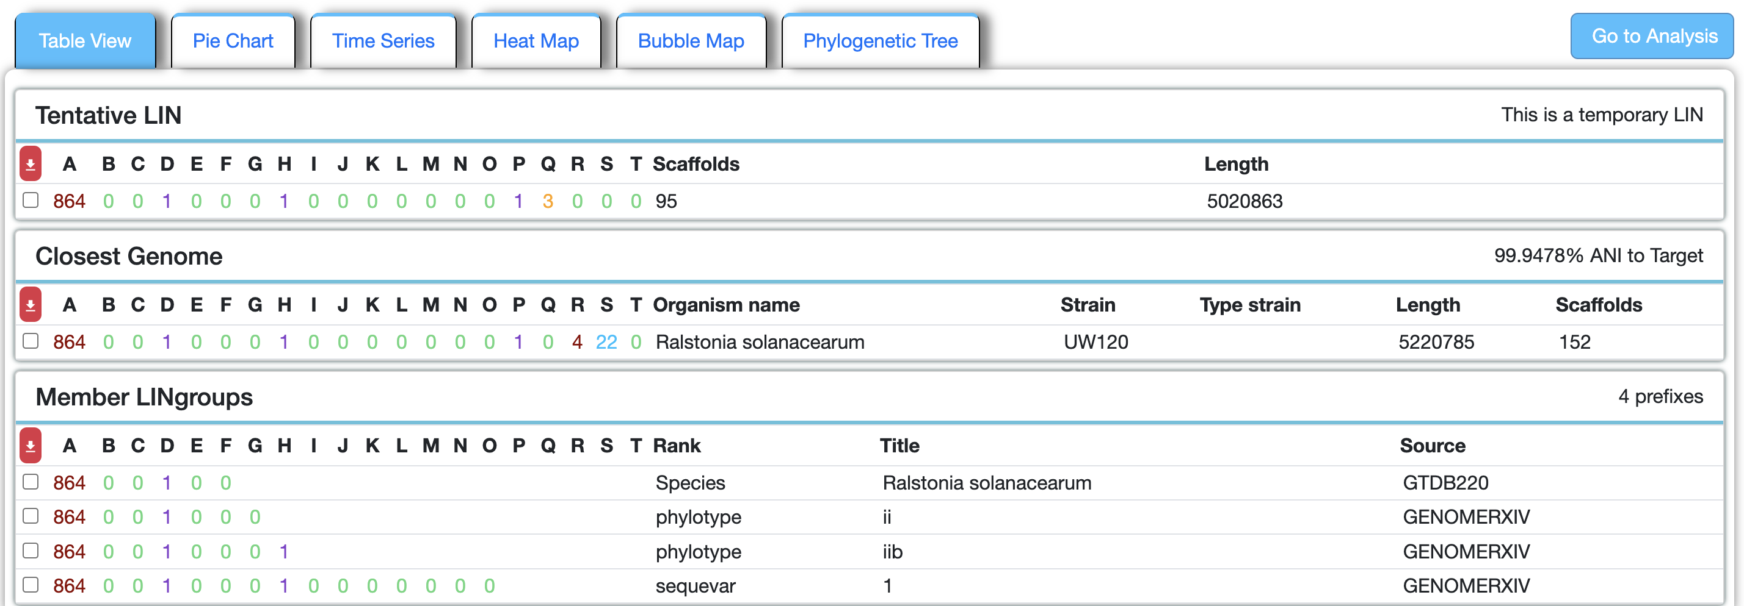
Sample with Ralstonia solanacearum sequevar 1 strain
Notes:
Units for parameters

Slide 6
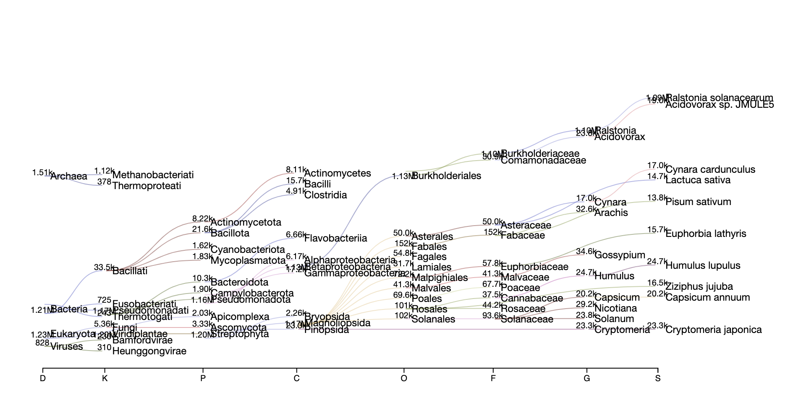
Kraken2 Classification Results
Sample with Ralstonia solanacearum sequevar 1 strain

Slide 7
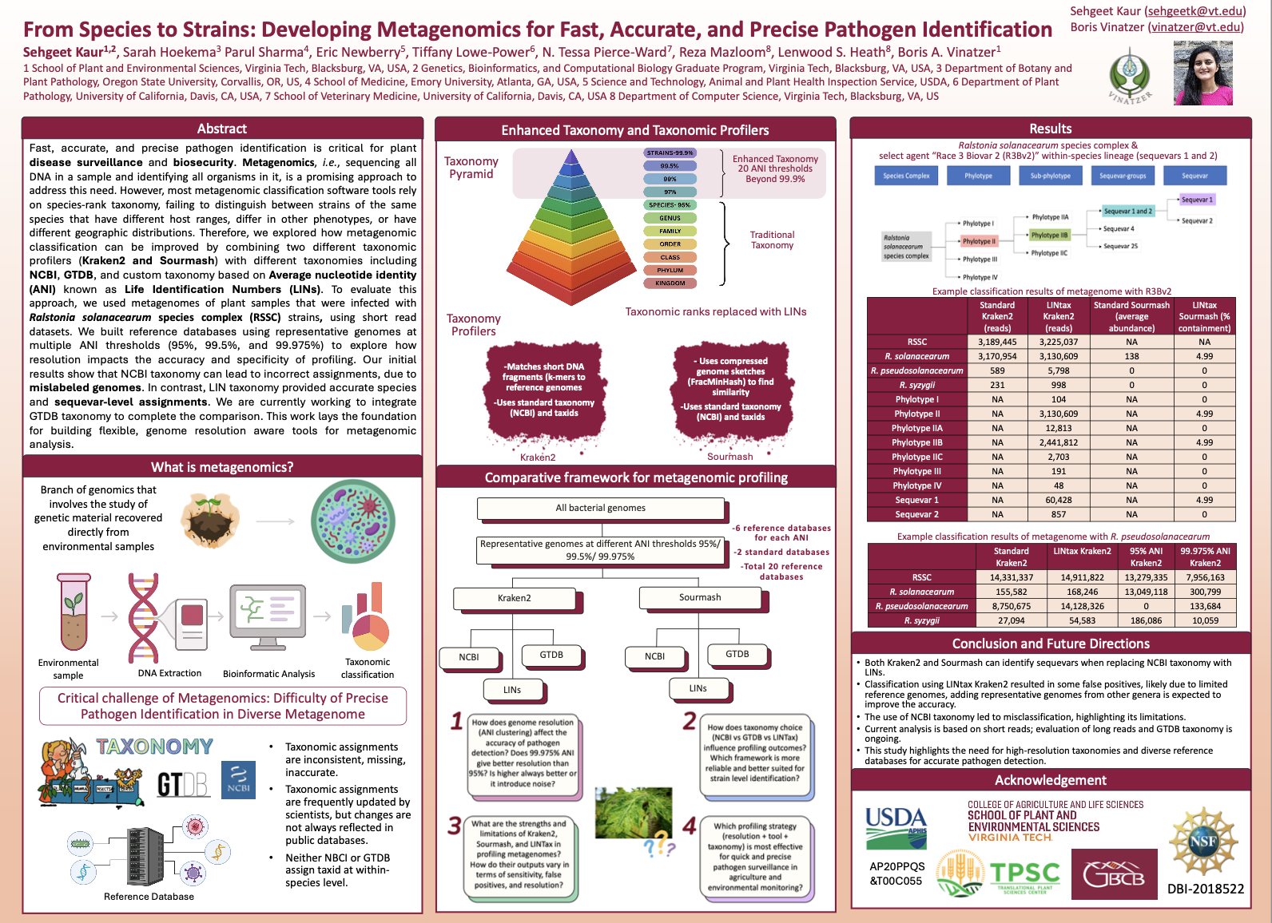
P-185
8/4/25 – 3.45-4pm

